Slide 1


AngularJS 1.0 & Facebook Login using firebase API
- By Pulkit Kakkar

Slide 2




What We are Going To make ?
We are laying fundamentals to build a Group Chat Box with Following Features :-
Create Account Using Facebook Login
Sign-In Page Using Firebase Auth API
Option to create new Chat Box(Group)for Each Topic
Group Chat for each Chat Box
Change ChatBox(Group) Image

Slide 3
Intro To Angular JS
A Brief History About AngularJS
Why Angular JS
Intro To MVC Programming Paradigm
HelloWorld
Controllers
Views
Routing
Directives(built-in and custom)
Filters
Service, Providers, Factory

Slide 4

History Of Angular JS

Slide 5

Why Angular JS ?
1 - It Was Developed by Google
This one may seem obvious, but it's important to remember that many (not all) frameworks are made by hobbyists in the open source community. While passion and drive have forged frameworks, like Cappucino and Knockout, Angular is built and maintained by dedicated (and highly talented) Google engineers. This means you not only have a large open community to learn from, but you also have skilled, highly-available engineers tasked to help you get your Angular questions answered.

Slide 6
2- It’s Declarative and not Imperative
In contrast to the imperative programming, declarative programming is about describing what you're trying to achieve, without instructing how to do it. Read on and check out my presentation on programming paradigms.

Slide 7
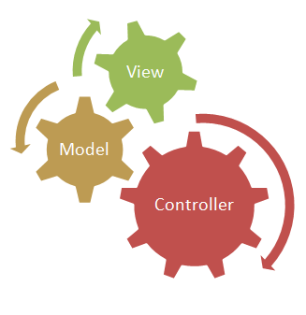
3- it’s MVC
What is MVC?
The Model-View-Controller (MVC) is an architectural pattern that separates an application into three main logical components: the model, the view, and the controller. Each of these components are built to handle specific development aspects of an application. MVC is one of the most frequently used industry-standard web development framework to create scalable and extensible projects.

Slide 8



MVC Analogy
Request
Ask for Data
Render on
Screen
Gets Data
View(Browser)
Controller(Server)
Model(database)

Slide 9
MVC Components
Model | View | Controller
The Model component corresponds to all the data related logic that the user works with. This can represent either the data that is being transferred between the View and Controller components or any other business logic related data. | The View component is used for all the UI logic of the application. For example, the Customer view would include all the UI components such as text boxes, dropdowns, etc. that the final user interacts with. | Controllers act as an interface between Model and View components to process all the business logic and incoming requests, manipulate data using the Model component and interact with the Views to render the final output

Slide 10
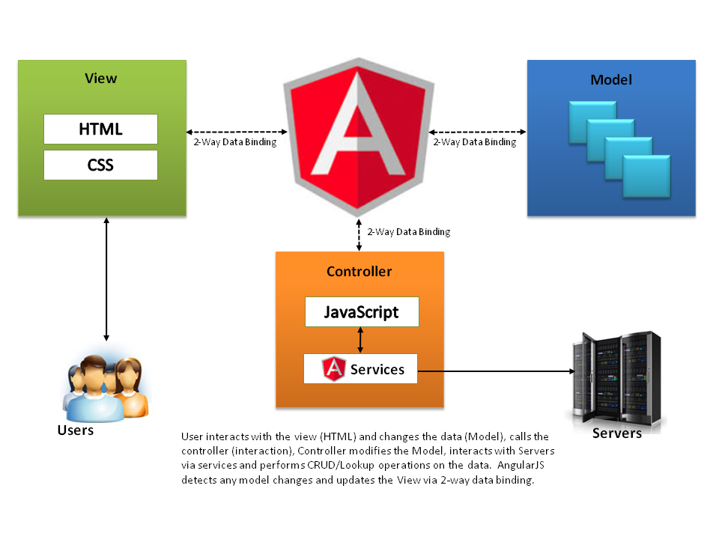
MVC Relationship in Angular

Slide 11
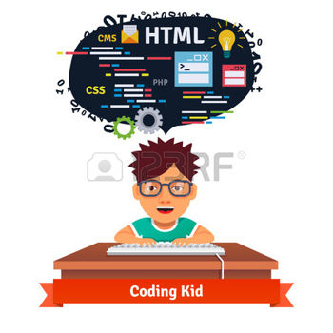


Lets Start With Real-Time Coding
“Most good programmers do programming not because they expect to get paid or get adulation by the public, but because it is fun to program.” – Linus Torvalds

Slide 12
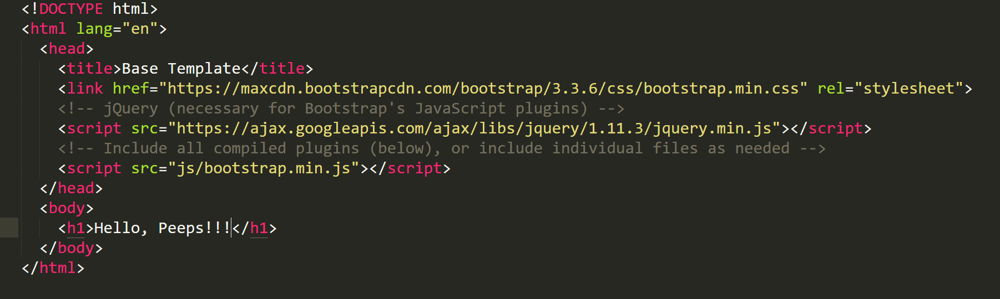
Installing Angular JS
1. Open Your Base Template :

Slide 13
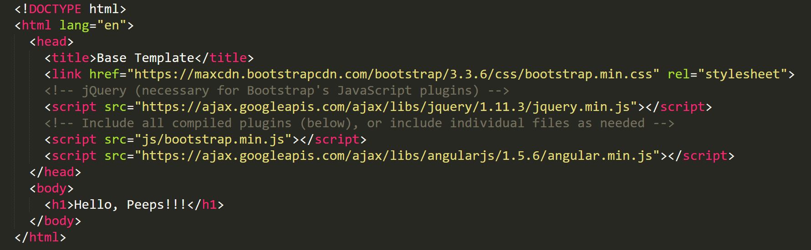
2. Copy The Following Line into Your Code
There are two types of Angular script URLs you can point to, one for development and one for production:
angular.js — This is the human-readable, non-minified version, suitable for web development.
angular.min.js — This is the minified version, which we strongly suggest you use in production.
3. This is How our Final Code Looks Like , Congrats you’ve Finally installed angular, You may use the other installation
options available at https://docs.angularjs.org/misc/downloading

Slide 14
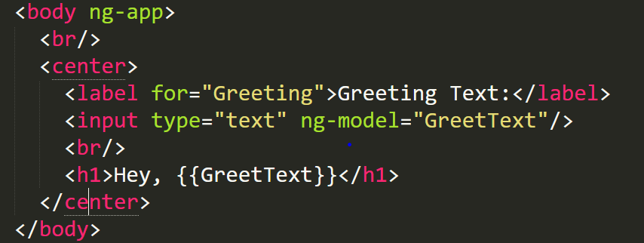
HelloWorld
In Order To illustrate the basic concept of Angular JS, We’ll Code a basic HelloWorld which
Simply binds an input from text field , to the heading tag
Code:
** Code Available in file ‘1 Helloworld.html’

Slide 15
What’s Different ??
i.) ng-App
The green colored attribute above are colored Directives in AngularJS, Directive often starts with ‘ng’ or ‘data-ng’
Read more about ng VS data-ng at: http://stackoverflow.com/questions/16589853/ng-app-vs-data-ng-app-what-is-the-difference
ng-app directive is used to auto-bootstrap an AngularJS application. The ngApp directive designates the root element of the application and is typically placed near the root element of the page like <body> or <html>
Remember Few things :
Only one AngularJS application can be auto-bootstrapped per HTML document.To run multiple applications in an HTML document you must manually bootstrap them using angular.bootstrap function instead
AngularJS applications cannot be nested within each other.

Slide 16
What’s Different ??
ii) ng-model
The ngModel directive binds an input,select, textarea (or custom form control) to a property on the scope
Note: ngModel will try to bind to the property given by evaluating the expression on the current scope. If the property doesn't already exist on this scope, it will be created implicitly and added to the scope.
Read more at : https://docs.angularjs.org/api/ng/directive/ngModel
iii) Double Curly Brackets {{Model_Name}}
The double curly brace notation {{ }} to bind expressions to elements is built-in Angular markup.
It Can also be used to perform basic mathematical operations

Slide 17
Directory Structure for Angular Apps
Main Folder
Index.html
JS
CSS
Images
app.js
Controller.js
Style.css
Views
Partial01.html
Partial02.html

Slide 18
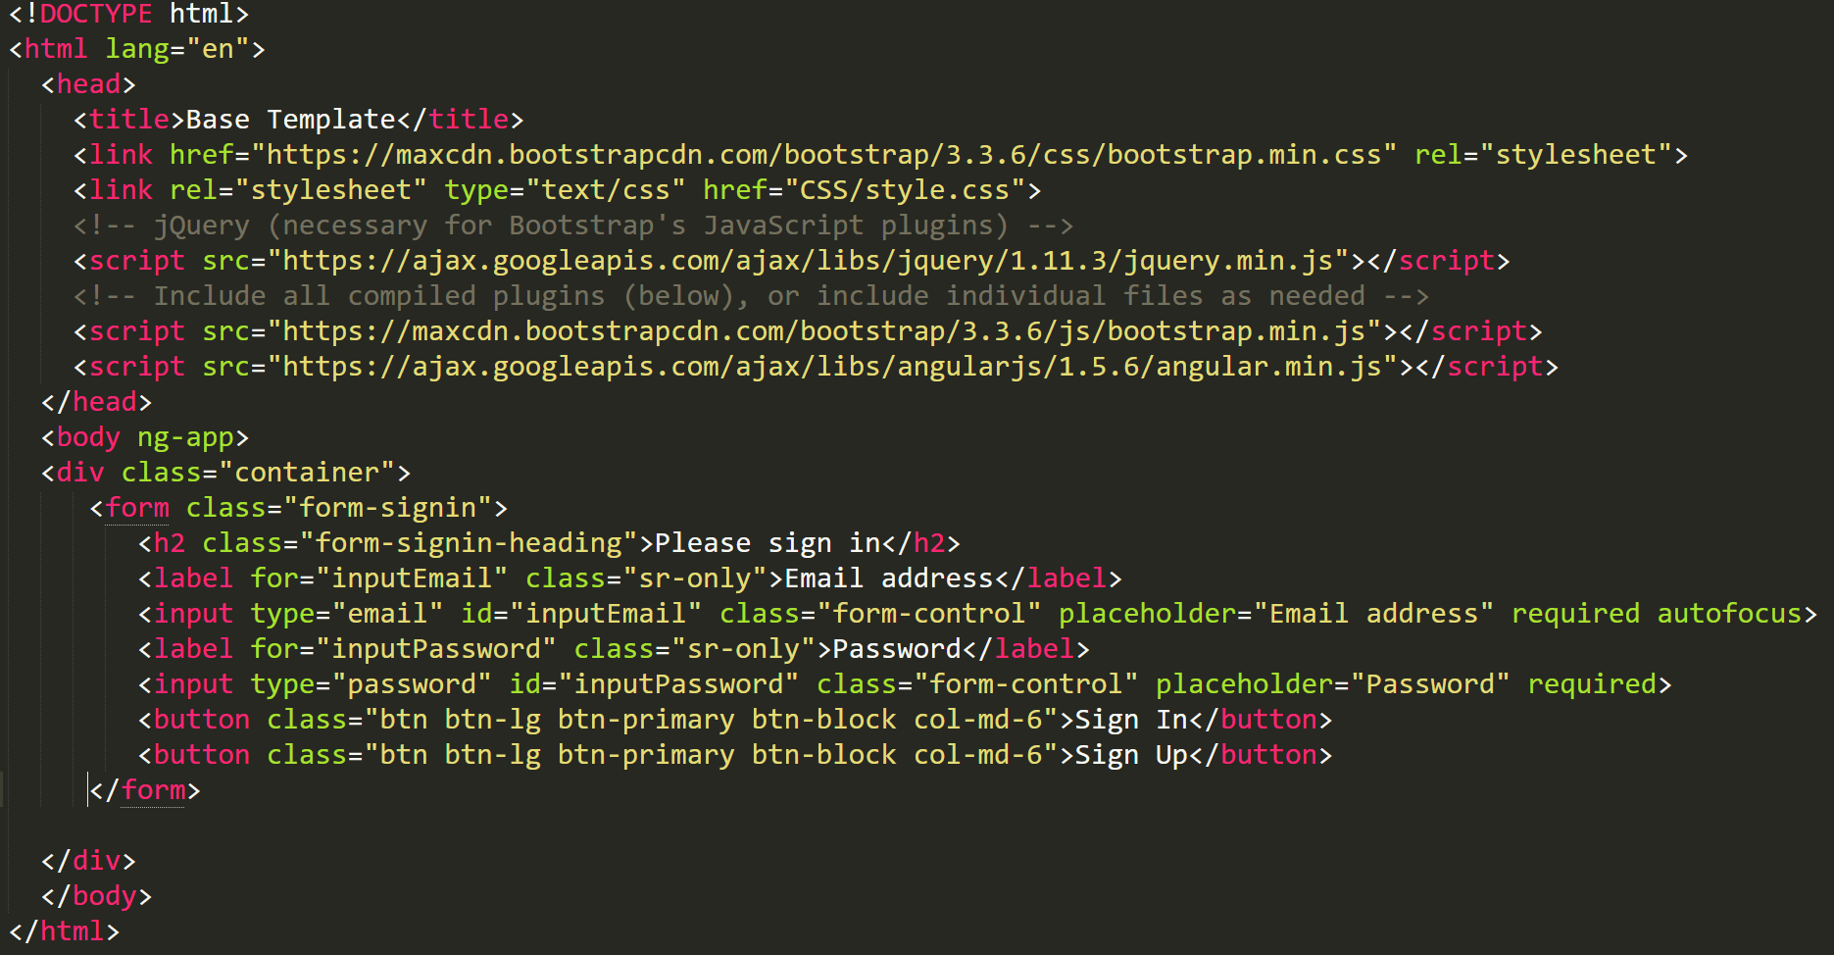
Getting Started With Chat App

Slide 19
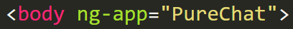
Creating Module
An AngularJS module defines an application. It Defines the scope of an application. It is a container for the different parts of an application. It contains services, directives, controllers, filters, and configuration information
An App may have multiple modules but right now we just have one module named “PureChat”
To Define a module Open JS Folder and add following line to your app.js:

Slide 20
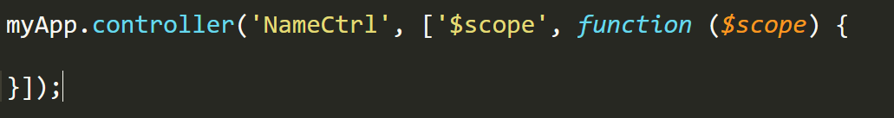
Controllers
Controllers are used to create Presentational Logic for the applications
They are also used for Scope initializations
They shouldn’t be used for writing Business Logics, Factory and services must be used instead
It shouldn’t also be used for DOM manipulation and Filteration
Syntax For Defining Controller :

Slide 21
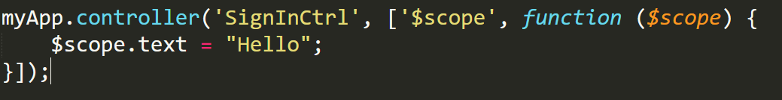
Sign in Controller Detail
Let’s Create Our very First Controller For Signing In , and name it as “SignInCtrl”
Scope Properties can be accesed only within the scope of controller
A module may have more than one controllers
It Can Be used for initializing too, but ng-init is a better option
Functions can also be declared to the scope properties, as illustrated.
Double Braces can also be used to invoke a function and print the return parameter

Slide 22

Understanding $scope
$scope
It’s an object that refer to application model
They are arranged hierarchically
Access using $parent in nested controllers
They are intermediate between the view and controllers
Can by accessed using ng-model and ng-bind( braces and ng-bind notation)

Slide 23
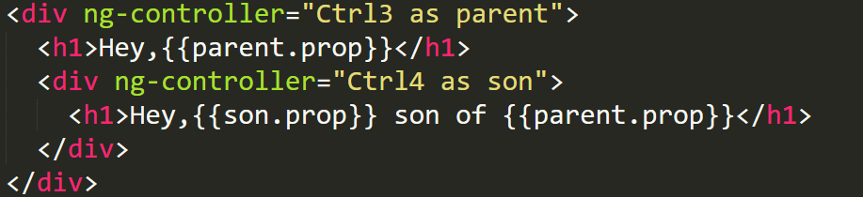
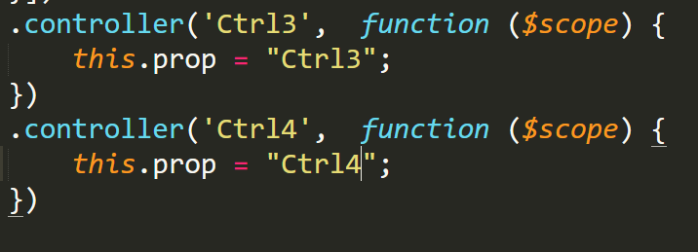
Using Controller As Syntax
Index.html
App.js

Slide 24

Angular Services
As mentioned earlier, services should be used to write the business logic of the application
Code is shared using the angular dependency injection
Services are Lazy Loaded and hence are good for memory management
Services are singleton (only one object)
Angular Provides a bunch of built-in services like :
$http (post, get)
$log (To log to console)
$filter
$locale etc….
You can Create your own custom service in angular

Slide 25
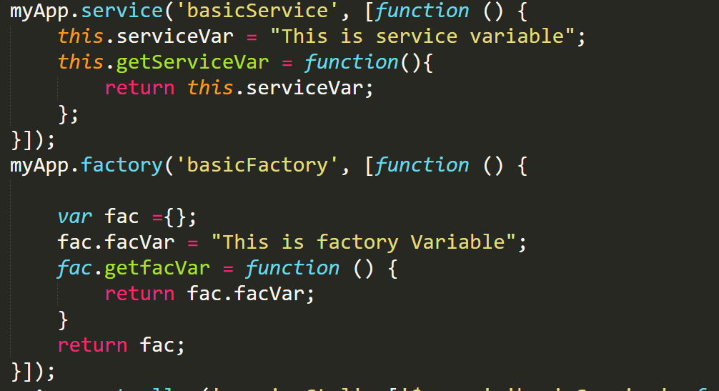
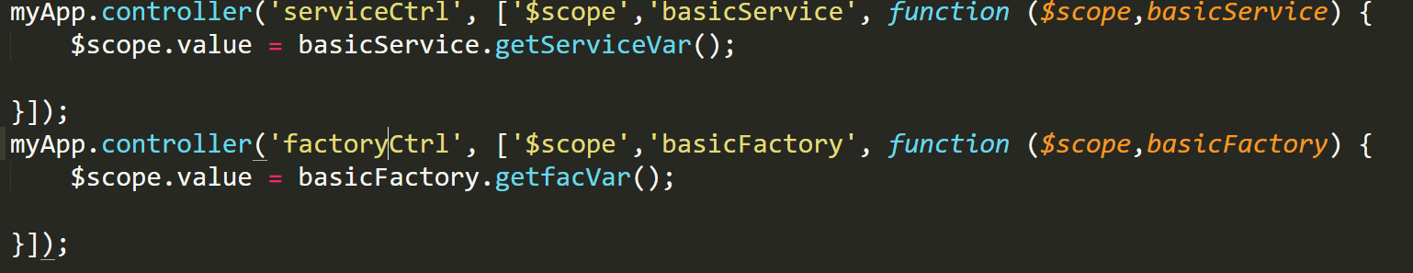
Service, Providers and Factory
Service, Provider and Factory does almost the same thing with just little difference
Service: Whenever a Sevice is initiated, angular creates an object with ‘new’ and hence all methods
and properties are accessed using ‘this’ keyword
Factory: It allows to only access the properties and methods returned by the factory
Provider: It’s The most verbose version of services, it can be configured

Slide 26

Best Practice
Do not Declare your Module as a global variable
Use “controller as” syntax instead of $scope
Separate factories , modules and services in different files
Do not write business logic in Controllers
Avoid $parent.$parent….. Syntax in nested controllers

Slide 27
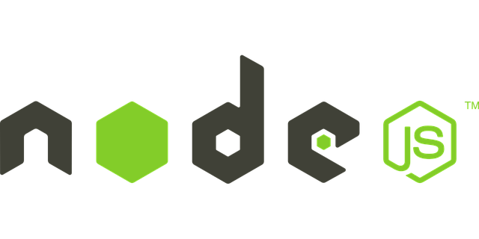
Routing in Angular SPA
If you want to navigate to different pages in your application, but you also want the application to be a SPA (Single Page Application), with no page reloading, you can use the ngRoute module.
The ngRoute module routes your application to different pages without reloading the entire application.
Routing Can not be tested on the local machine, so in order to use and test routing offline we’ll use nodeJS , http-server module

Slide 28
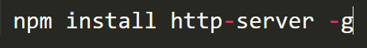
Setting up Http-server in nodejs
Download and install node from https://nodejs.org/en/download/
2) Open CMD and execute following command:
Once Installed , Use the command http-server in the CLI in the root of project, whenever you need
to create the local server
4) Read More at : https://www.npmjs.com/package/http-server

Slide 29

Ng-Route & NG-view
They both together provides, dynamic linking service for SPAs
They are used for deep linking
Ng-route couples with ng-view to provide linking
We set up our routing during the configuration phase of module, so that we have routing
ready before the application is bootstrapped
We can do this because in ‘config’ block of the module we can only inject constants or providers
and the routing component is a provider

Slide 30
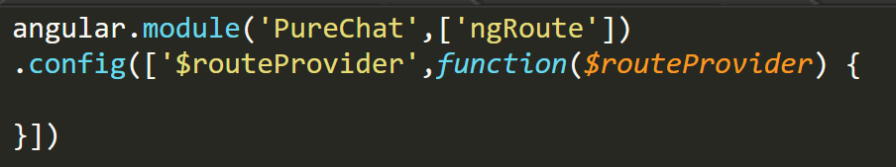
Setting Up Routing
1. Include angular-route.min.js in index.html
2. Add ngRoute in module dependency
3. Declare a config block and inject $routeProvider
4. Start Using It !!!

Slide 31
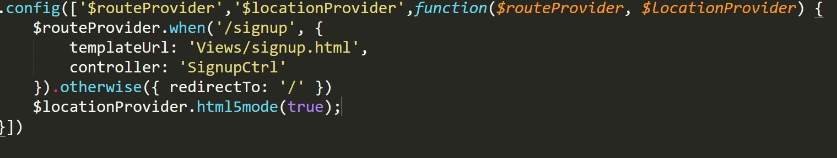
Add Sign UP View to chat app using routing
Add Sign-up view in Views folder
Configure the routeProvider
3) Use ng-href directive

Slide 32
Introduction To FireBase
Firebase is a cloud services provider and backend as a service company based in San Francisco, California.
Store Data in heirarichal form
User Authentication using Firebase
Good Bye SQL

Slide 33
Angular Fire and Firebase
AngularFire is the officially supported AngularJS binding for Firebase. The combination of Angular and Firebase provides a three-way data binding between your HTML, your JavaScript, and the Firebase database.
Create an account:
The first thing we need to do is sign up for a free Firebase account. A brand new Firebase app will automatically be created with its own unique URL ending in firebaseio.com. We'll use this URL to authenticate users and store and sync data with AngularFire.
2) Add Script Dependencies

Slide 34
Angular Fire and Firebase
3.) Inject the AngularFire Services
4) Now the $firebaseObject, $firebaseArray, and $firebaseAuth services are available to be injected into any controller, service, or factory.

Slide 35
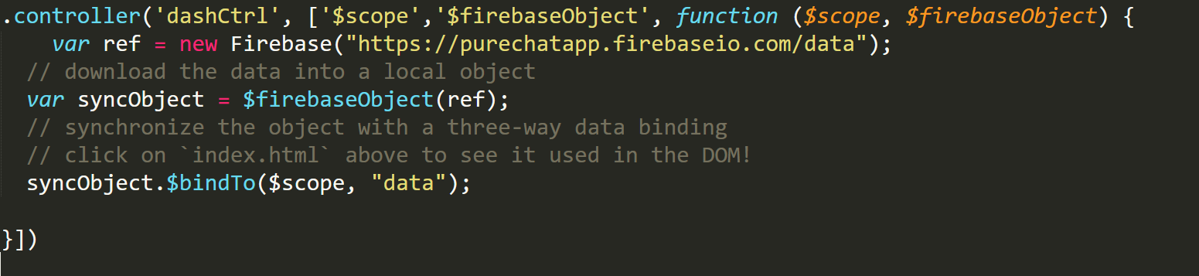
Add Three-Way, Object Bindings
Angular is known for its two-way data binding between JavaScript models and the DOM, and Firebase has a lightning-fast, realtime database. For synchronizing simple key / value pairs, AngularFire can be used to glue the two together, creating a "three-way data binding" which automatically synchronizes any changes to your DOM, your JavaScript, and the Firebase database.

Slide 36
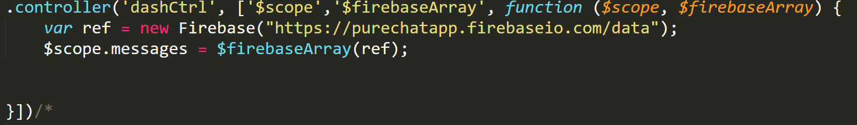
Synchronize Collections as Arrays
Three-way data bindings are amazing for simple key / value data. However, there are many times when an array would be more practical, such as when managing a collection of messages. This is done using the $firebaseArray service.
We synchronize a list of messages into a read-only array by using the $firebaseArray service and then assigning the array to $scope

Slide 37
Ng repeat directive
The ng-repeat directive repeats a set of HTML, a given number of times. The set of HTML will be repeated once per item in a collection. The collection must be an array or an object.

Slide 38
User Authentication
Firebase provides a hosted authentication service which offers a completely client-side solution to account management and authentication. It supports anonymous authentication, email / password login, and login via several OAuth providers, including Facebook, GitHub, Google, and Twitter.
AngularFire provides a service named $firebaseAuth which wraps the authentication methods provided by the Firebase client library. It can be injected into any controller, service, or factory.

Slide 39
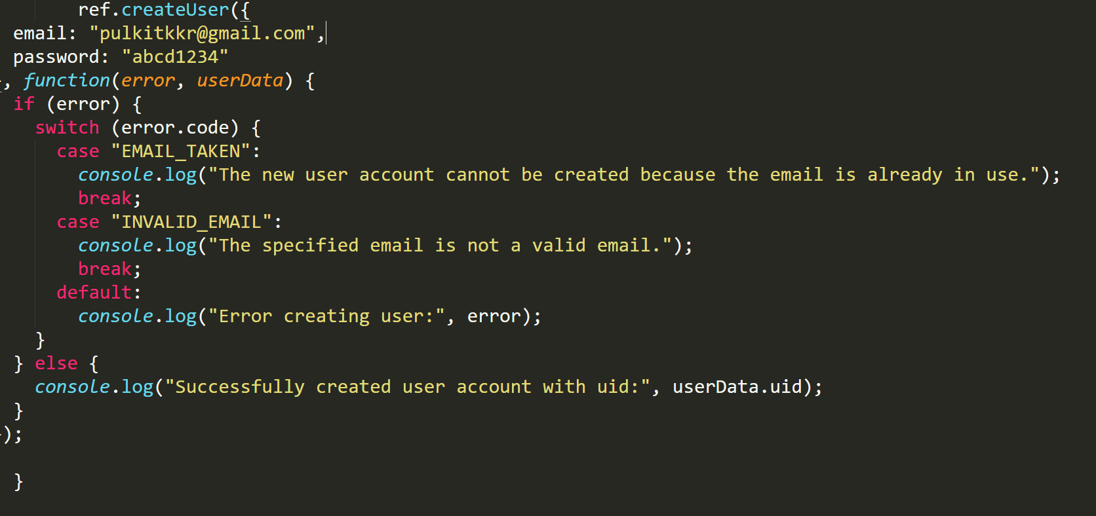
User Creation in firebase
createUser() Creates a new email / password user with the provided credentials. This method does not authenticate the user. After the account is created, the user may be authenticated with authWithPassword().

Slide 40
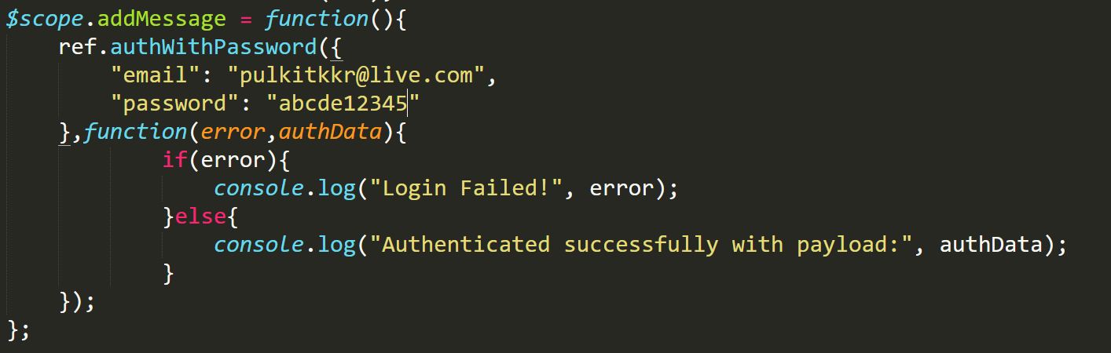
Logging in using AngularFire
authWithPassword() Authenticates a Firebase client using email / password credentials. The session will live until its configured expiration time in the Login & Auth tab of your App Dashboard, or when you explicitly end the session by calling unauth().

Slide 41
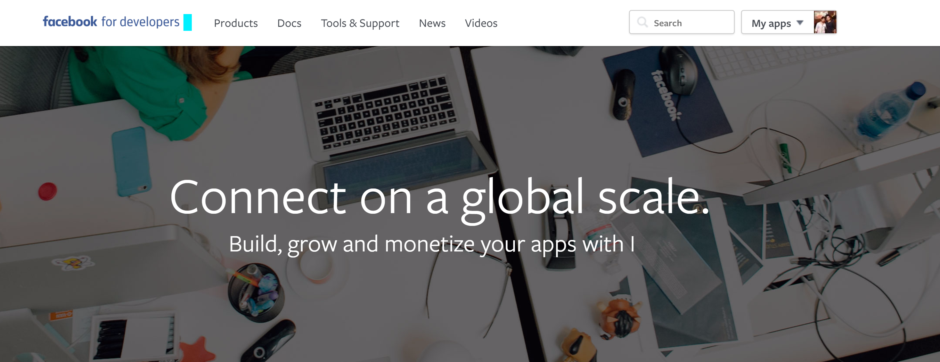
Logging in using facebook
1) Create a facebook app at facebook developer portal

Slide 42
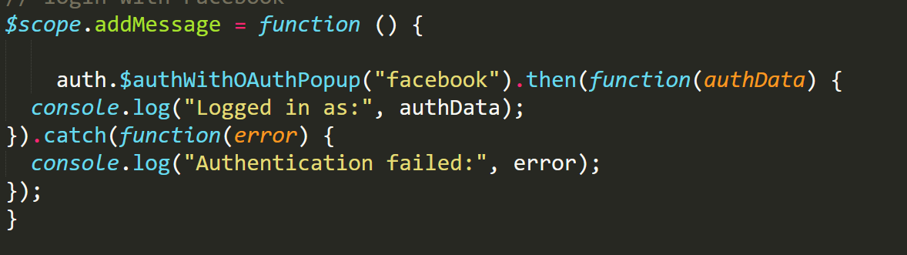
Facebook Login
2) Add following lines of codes :-
3) Help Yourself (Configurations, domains settings, Oauth redirect URI)

Slide 43



Wrapping All Up
Pulkit Kakkar
(pulkitkkr@gmail.com)
https://www.facebook.com/pkakkar1
https://www.instagram.com/pulkitkkr001/

